Slide 1
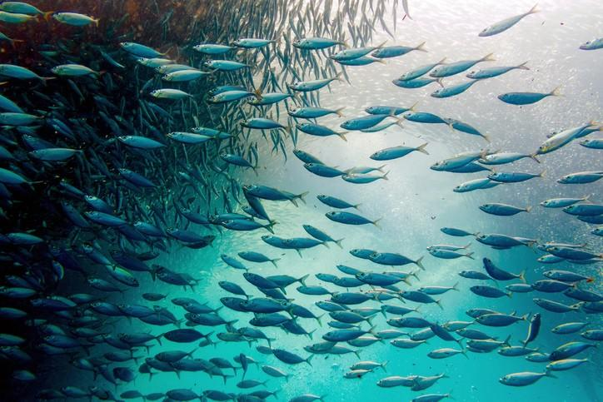

A data driven approach to Fisheries management
By Michal Velhartický and Omar Bennani
Class: CEBD 1151 - Big Data Analytics for Business
Instructor: Karim Lahrichi

Slide 2
Overview
Problem to solve
Project objective
Understanding the data
Data cleaning and feature engineering
Training the model and hyperparameter tuning
Solving the problem

Slide 3
Problem to solve
1
Billions of people are dependent on fish protein
3
Fishing is a main income source of millions of people in coastal communities
2
Bad practices of overfishing Decline in fish population Fisheries are pushed beyond their biological limits Overfished stock tripled in the past 50 years Unwanted by catch, further damaging the marine environment
Growing population in high demand of fish
4

Slide 4
Project objective
Predict the future level of fish caught fish
Suggest an imposed and regulated cap according to our model
Distribute the limits of fish catches accordingly to already existing areas
Assistance in focus on sustainable practices that help support livelihoods
Ensure food security
Preserve marine wildlife & ecosystems

Slide 5

Understanding the data

Slide 6

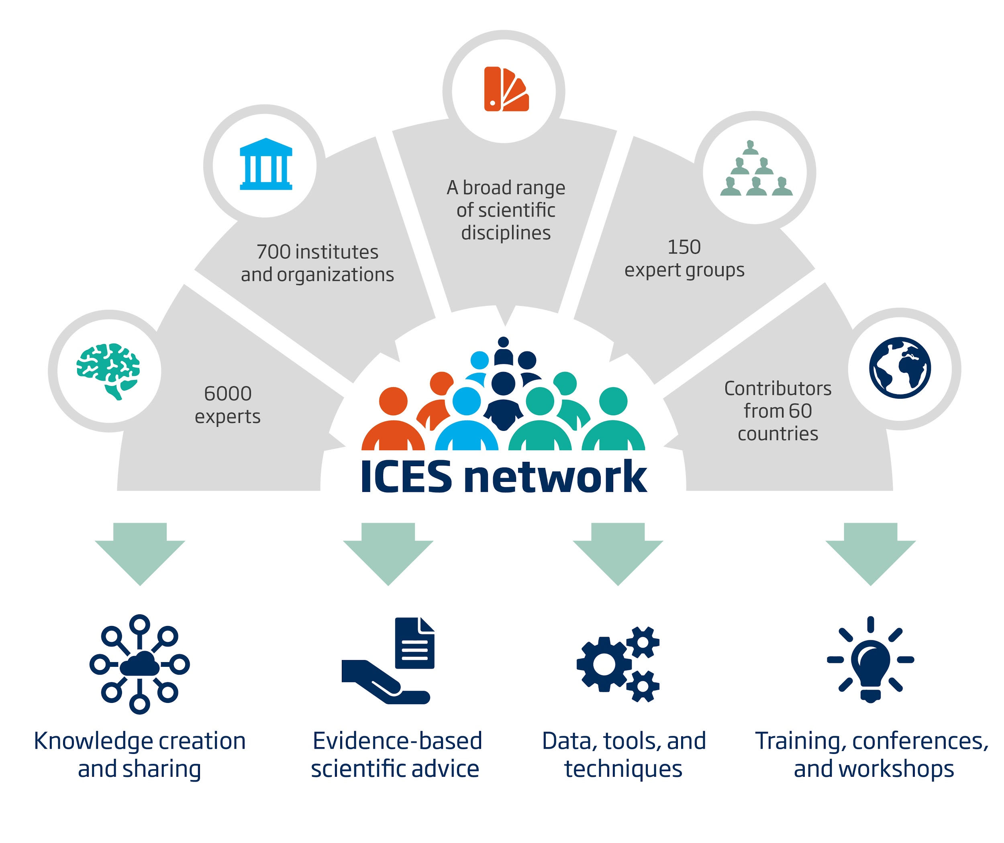
Data
200 species of annual nominal fish and shellfish catches in region of Northeast Atlantic
37 member countries of International Council for the Exploration of the Sea (ICES)
ICES provides
understanding of the state of marine ecosystems
generate conservation sustainability guidelines
Gathers historical data since 1904

Slide 7
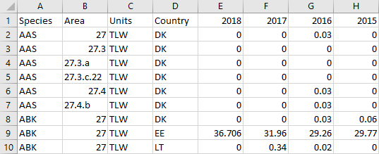
Data
Data from 2006 to 2018 of the Northeast Atlantic region ( FAO 27) TWL (tonnes of live weight) of fish, molluscs and other aquatic organisms for each species
Collected for each species 55810 in total, fishing area, country and year, country codes which are categorical
The unit is a column but not a feature
The TLW of fish is detailed for 13 years and can be used to predict future fish catches.

Slide 8
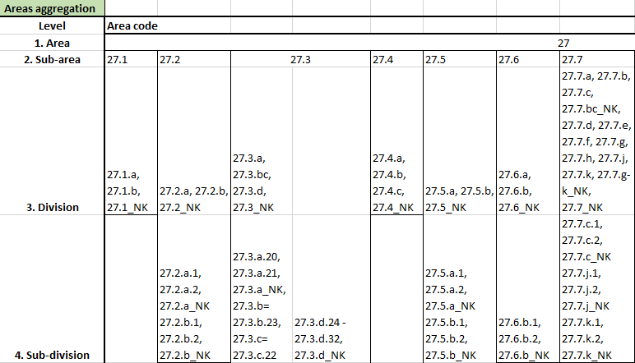
Data cleaning and feature engineering
Duplicate information due to area, sub-area, division, sub-division and unit
Each area contains information as whole or only sub-area, etc.
Decided to keep sub-area to avoid duplicates
Drop column 2018 - letter “C”, which is not a numerical
Countries with low data/influence were therefore removed
Rows with zero values were removed, no expected prediction other than zero

Slide 9
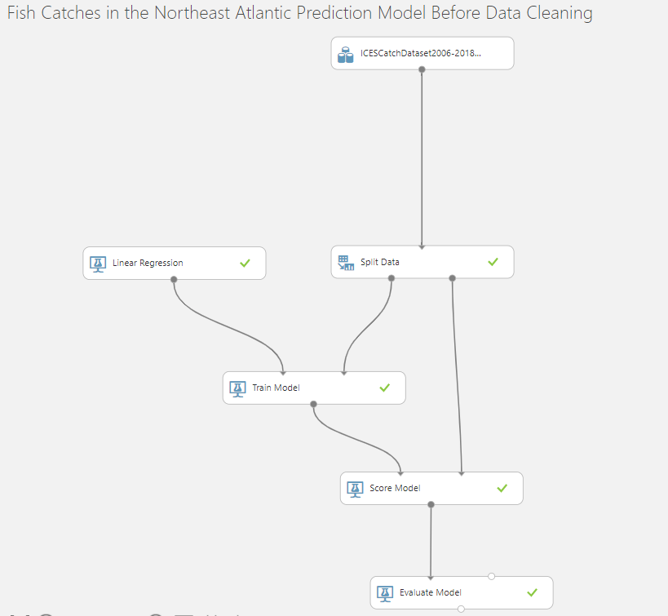
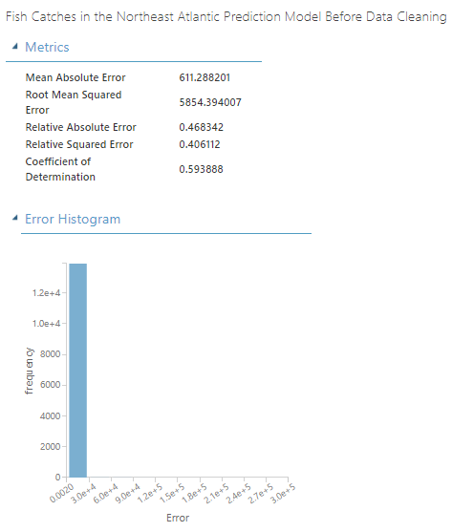
Initial results before data cleaning
Using the original dataset and training a linear model with the target as the year 2017 and a split ratio of training set and validation set of 0.75:
MAE 611.28,
RMSE 5854.39
R² 0.5939

Slide 10
Data cleaning and feature engineering
Following data cleaning, the target was set as the year 2017, MAE is 580.39, the RMSE is 5442.46 and R² is 0.7437, which is noticeable improvement.
Feature engineering, adding new features calculated from original features
Adding the increase percentage of the most recent year vs the previous year, e.g. 2016 being the most recent and 2015 previous
Not to leak 2017
Other added features: median & mean without 2017

Slide 11
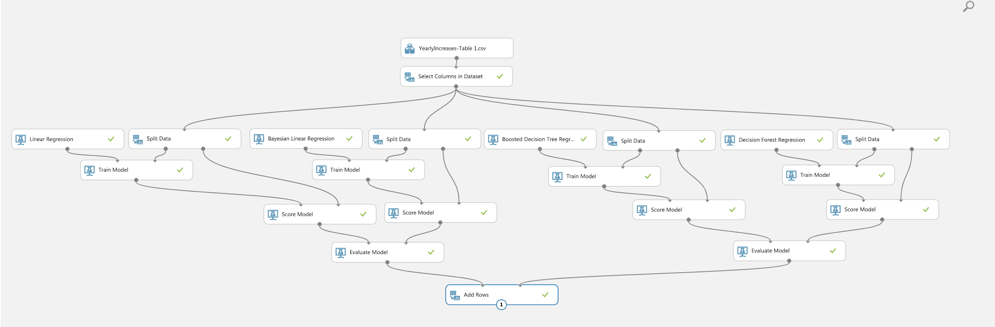
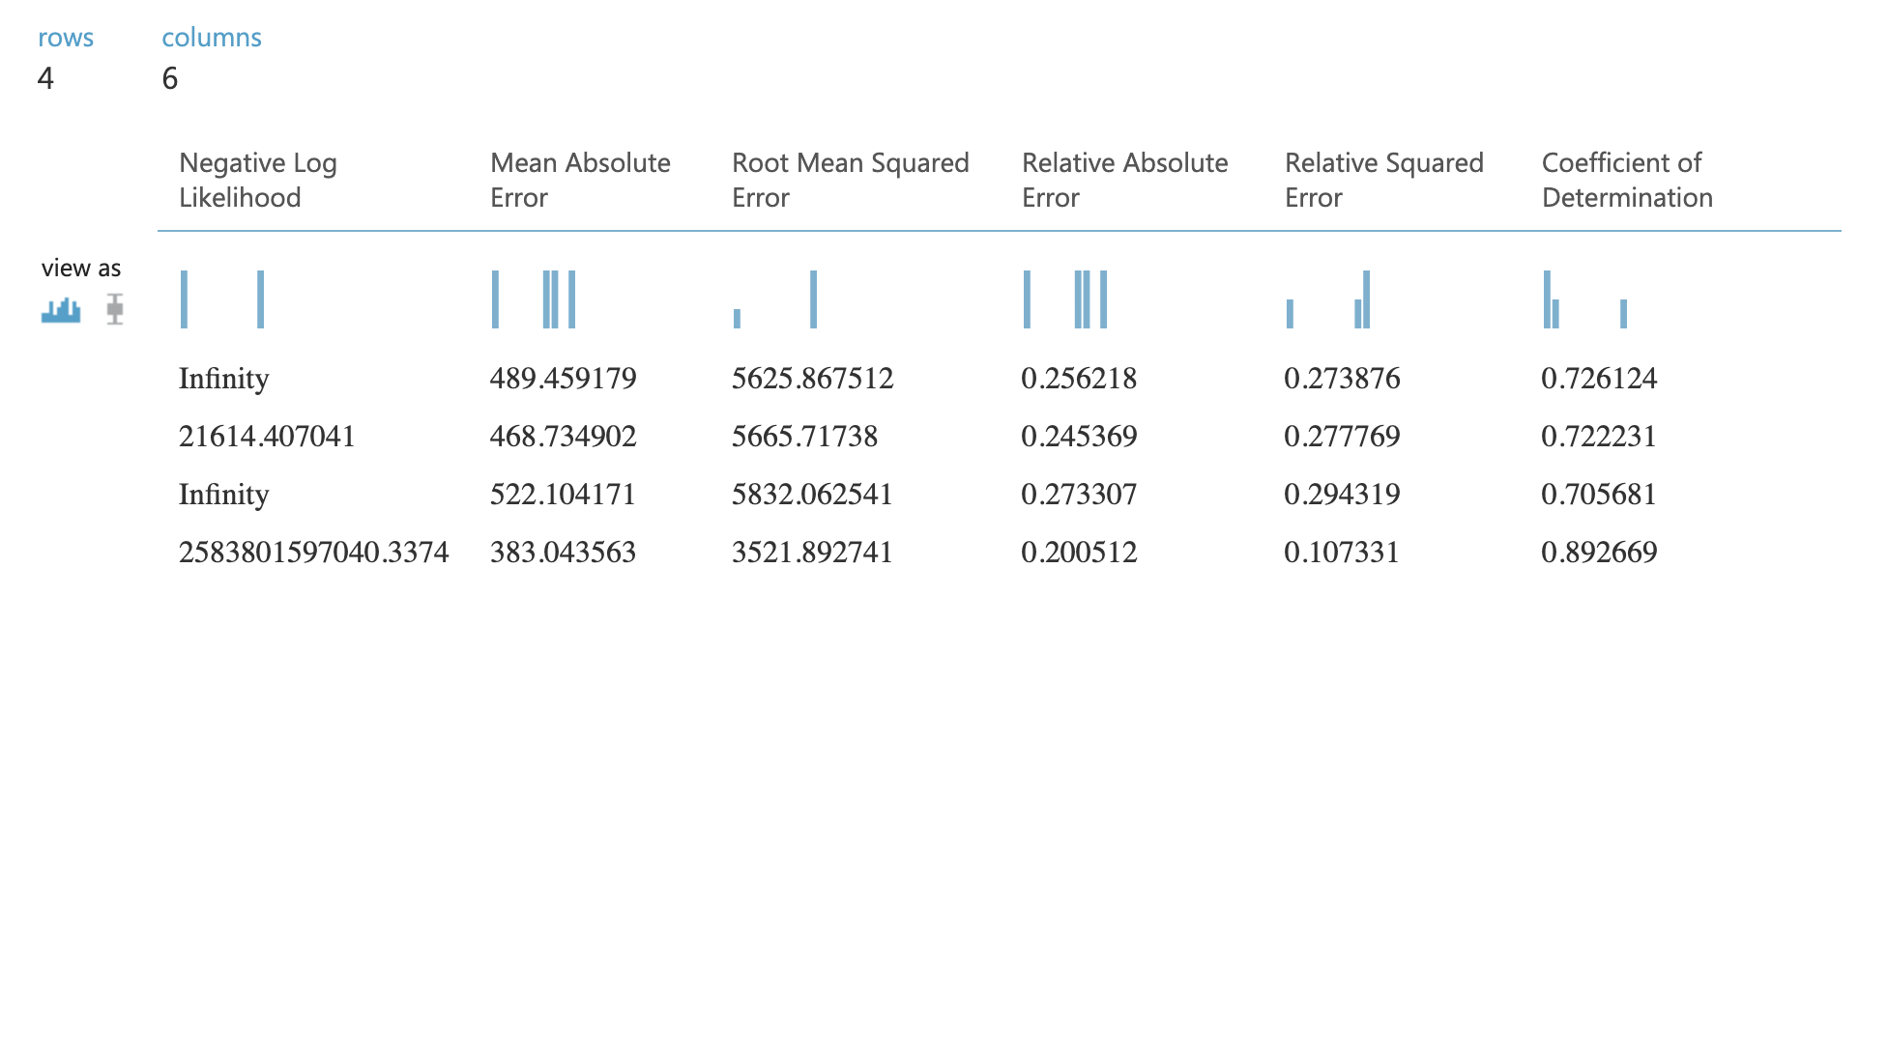
Results after data cleaning and feature engineering
For a linear model, these changes did not improve the performance.
Boosted tree model and decision forest model, feature engineering improved the results
Decision forest regression model offers the better performance:
MAE 383.04
RMSE 3521.89
R² 0.8927

Slide 12
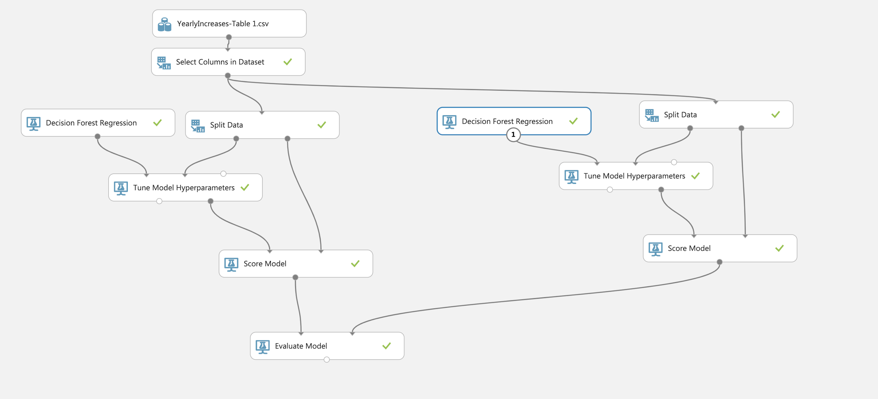
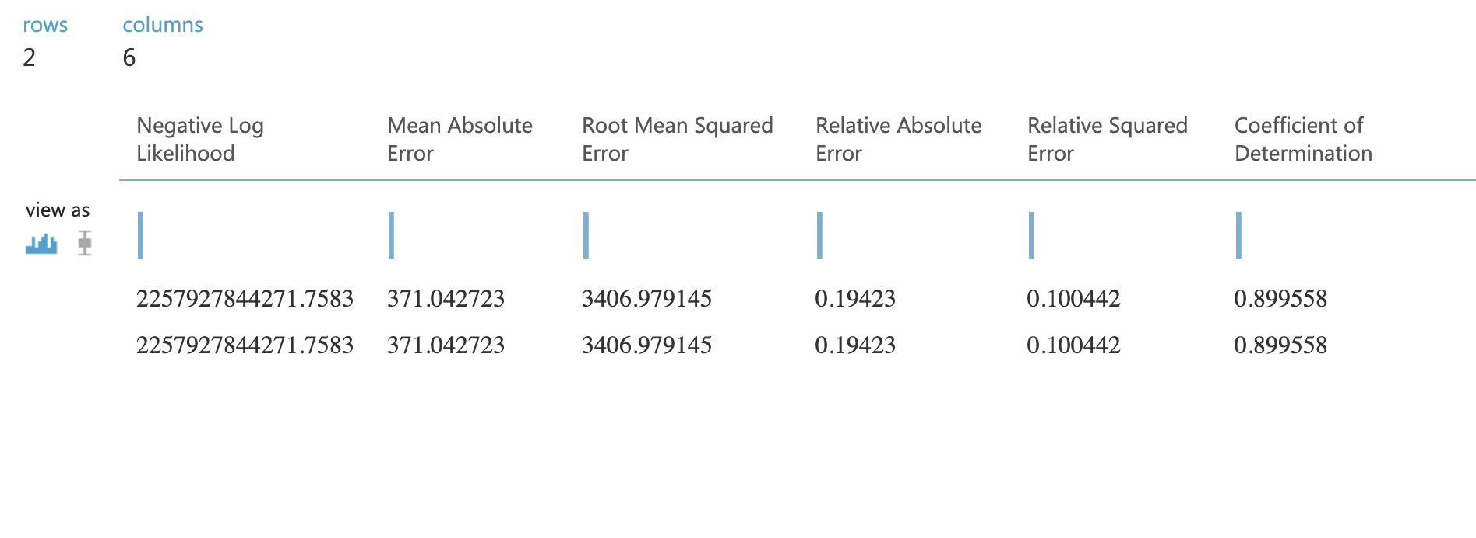
Training the model and hyperparameter tuning
Hyperparameter tuning
Parameters: random sweep mode, maximum number of 5 runs, random seed 0, for target we used 2017
The performance did not improve
Hyperparameters tuning used the entire grid testing for each possible combination -> longer processing time
The decision forest regression was slightly improved with
MAE of 371.04 RMSE of 3406.98 and R² of 0.8995

Slide 13
Solving the problem
Give a predicted amount of fish per species
Use as a cap beyond which the specific population will not be exploited for that year
Prevent extinction of species of fish
Amounts to be limited according to sub-areas, etc.
Assist in bringing a sustainable and stable marine wildlife
Assure continuous income to coastal communities

Slide 14
Real life uses
A realistic fish-habitat dataset to evaluate algorithms for underwater visual analysis. https://www.nature.com/articles/s41598-020-71639-x
Managing fish populations with artificial intelligence
https://ourenvironment.berkeley.edu/news/2019/07/managing-fish-populations-artificial-intelligence
Application of machine learning models to predict fish species distributions in Alaskan estuaries
https://access.afsc.noaa.gov/pubs/posters/pdfs/pMillerKath01_machine-learning.pdf
Predicting Fishing Effort and Catch Using Semantic Trajectories and Machine Learning https://link.springer.com/chapter/10.1007/978-3-030-38081-6_7
One Fish, Two Fish: How Machine Learning Can Enhance Fisheries Management https://digital.hbs.edu/platform-rctom/submission/one-fish-two-fish-how-machine-learning-can-enhance-fisheries-management/

Slide 15
Thank you.

